Slide 1
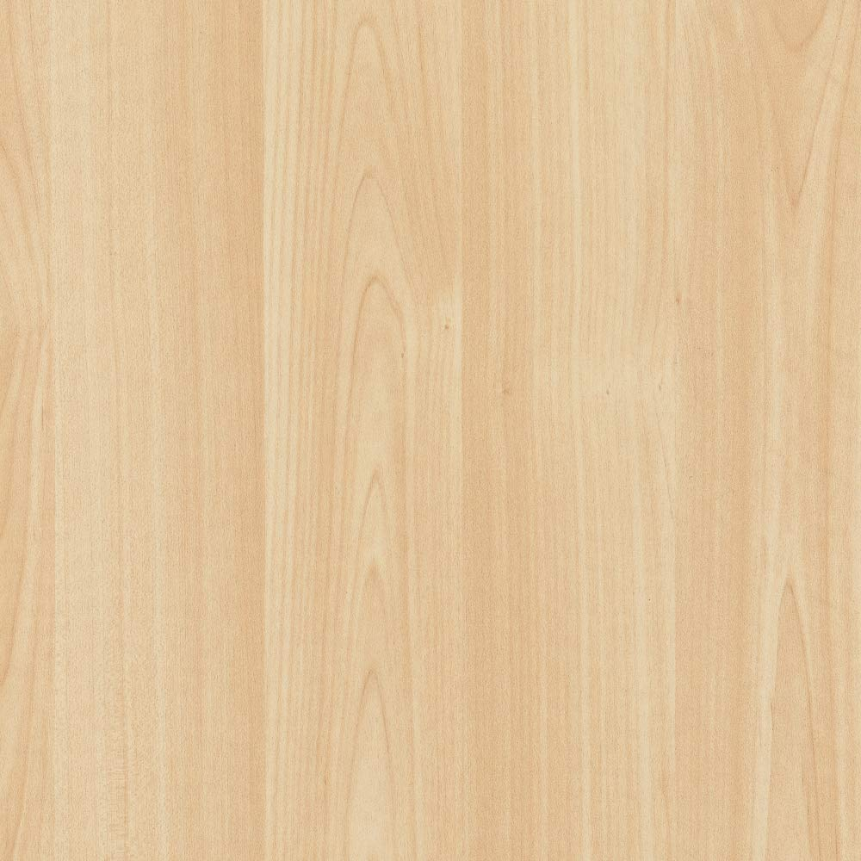
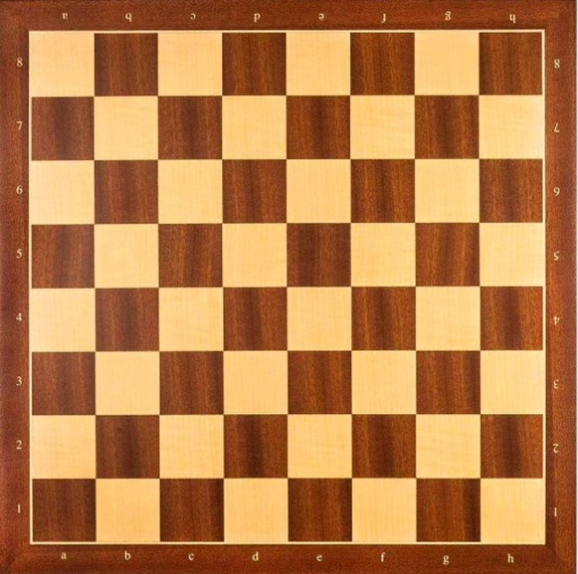

Chess
Ai:
Player:
How to Play:
Press play button to start
Select chess piece to move
Select area to move to
Try to win!

Slide 2
Chess

